Slide 1


CareerRatRace.com
Made by:
PRIYA KAUR
SUNIDHI MALHOTRA
SAGGARIKA DATTA
GURPREET BEDI
HEMANT KUMAR

Slide 2


CAREER COUNSELLING & COMPETITVE EXAMS

Slide 3


OUR AIM:
Knowing yourself
It is very important to know
ourselves .
Spending time with oneself and
exploring our interests before we go to anyone else.
Exploring your options
Getting confused in various options is very normal but

Slide 4

Making Decision
The online counselling test will help the
individual to Make right decision.
Performing & Enhancing of Prospects
We have given proper material along
with short tests for various
departments and their future
Prospects.
Never give up on something
you really want..!

Slide 5

COMPETITIVE EXAMS
After deciding the stream the work is not finished..
What next ..?
Getting the desired output and job is not that easy…there
Comes the competitive exams.
We have provided various options and horizons where one can
Look and find the long term career of his/her dreams.
Giving short tests on the latest formats of different exams give the student an insight on what it is like to give the paper.

Slide 6

So what do we need..??

Slide 7

CareerRatRace.com

Slide 8
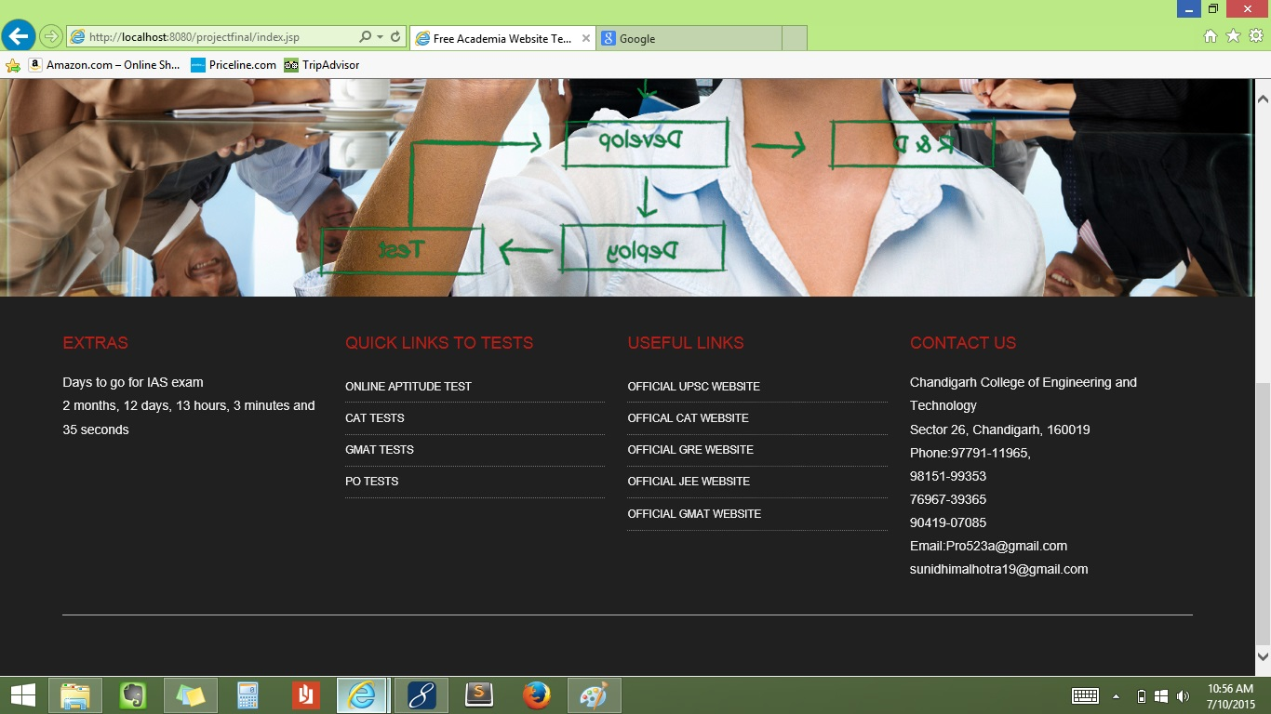

Slide 9
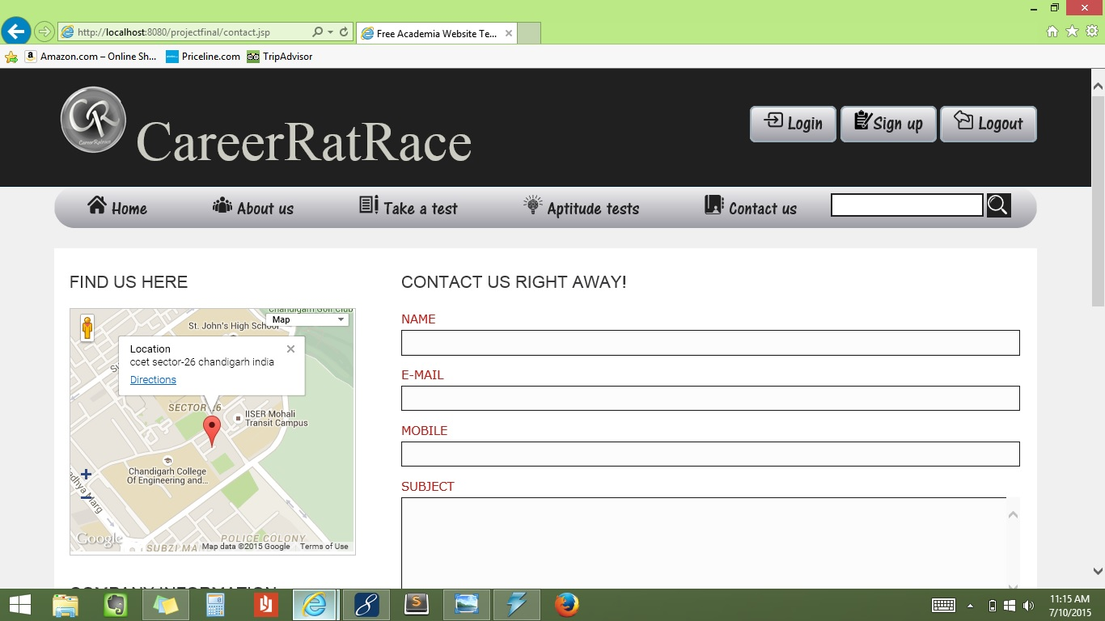

Slide 10
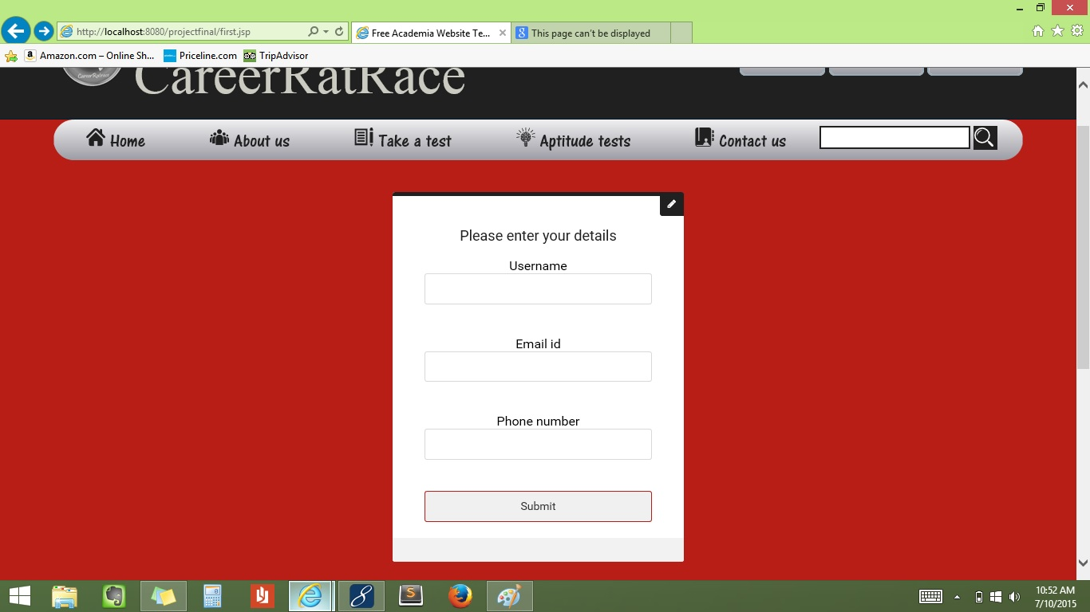

Slide 11
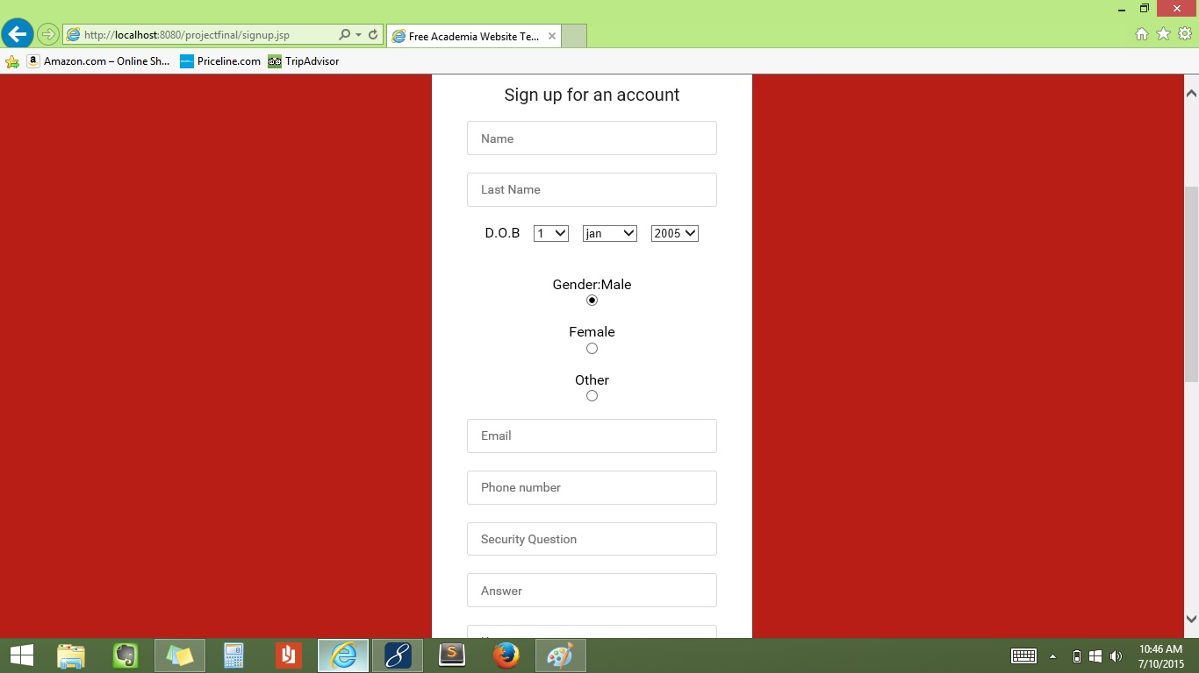

Slide 12
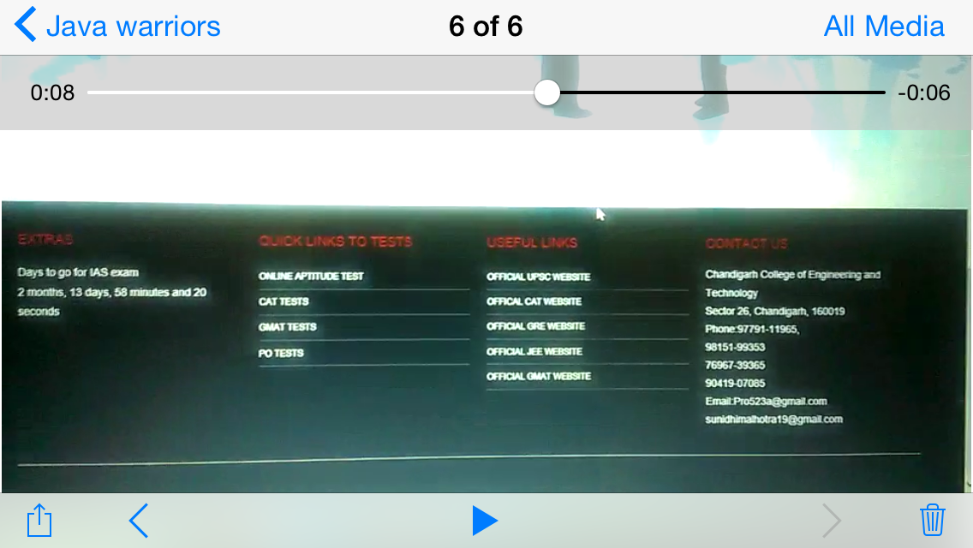
*** Latest news on examination and updates -- dates & time etc. *** Quick links to short tests on various competitive exams *** we provide the original link to the Official websites conducting the exams..!

Slide 13


TAKE A TEST ON COMPETITIVE EXAMS
*GATE
*GRE
*GMAT
*JEE
*IAS
*BANKING

Slide 14
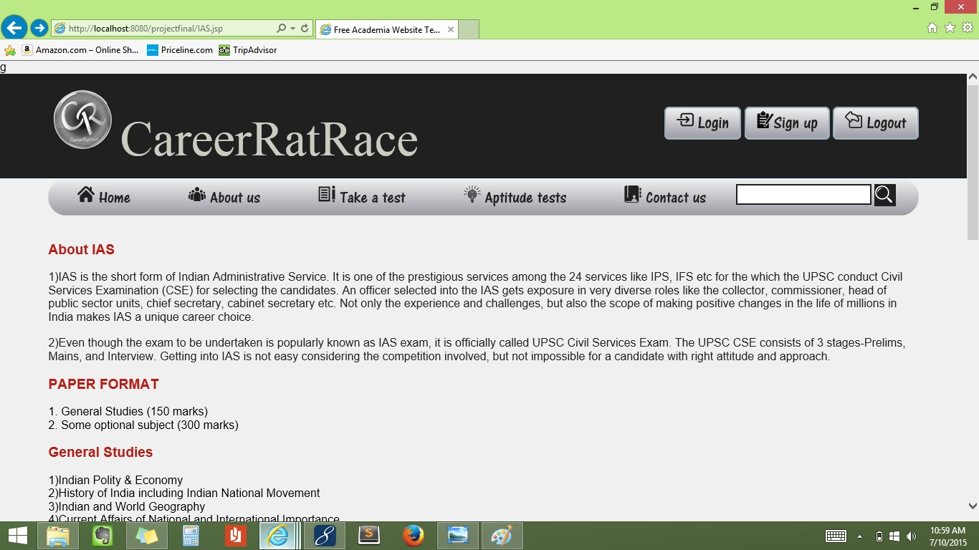

Slide 15
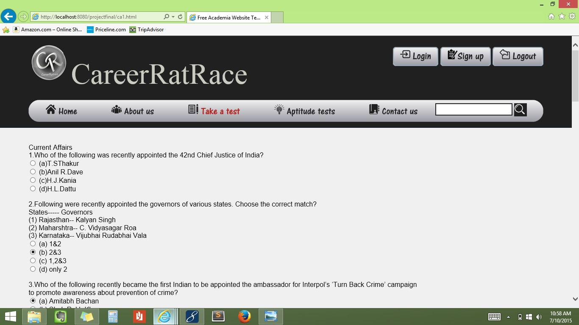

Slide 16

THANK YOU..!

